Slide 1

Exploratory Data Analysis ON Ameo Dataset
Ch.Pranavi
Notes:
NOTE:
To change the image on this slide, select the picture and delete it. Then click the Pictures icon in the placeholder to insert your own image.

Slide 2
Objective of the Project:
The main objective of the project is to perform exploratory data analysis and gain insights from the AMEO dataset.
In this we have so many independent features and the target column Salary, we should analyze the relationship between those columns and the salary column.
We should find the underlying trends and patterns associated with the data.
DATASET DESCRIPTION:
The dataset was released by Aspiring Minds from the Aspiring Mind Employment Outcome 2015 (AMEO). The study is primarily limited only to students with engineering disciplines. The dataset contains the employment outcomes of engineering graduates as dependent variables (Salary, Job Titles, and Job Locations) along with the standardized scores from three different areas – cognitive skills, technical skills and personality skills. The dataset also contains demographic features. The dataset contains around 40 independent variables and 4000 data points. The independent variables are both continuous and categorical in nature. The dataset contains a unique identifier for each candidate

Slide 3
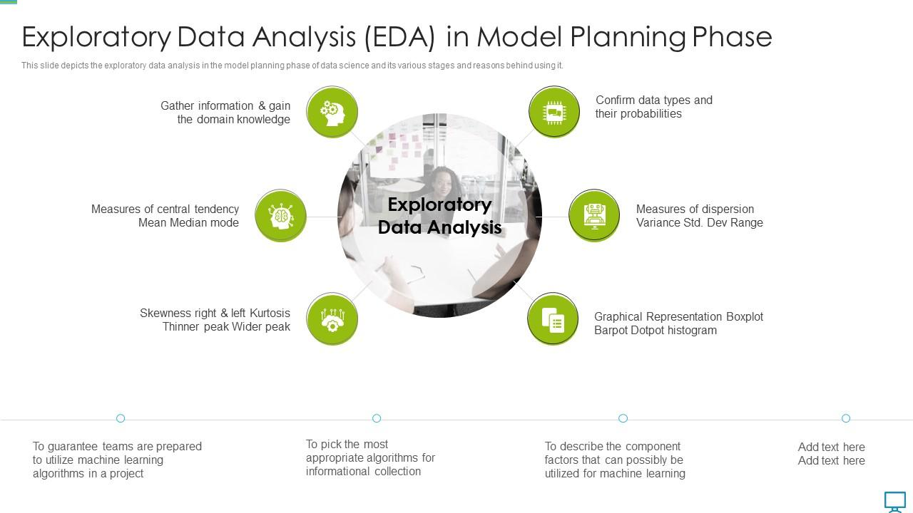
EXPLORATORY DATA ANALYSIS(EDA) PROCESS:
These are the general steps what we need to follow while doing the EDA analysis.

Slide 4
Data Cleaning and Preprocessing:
We can see the DOJ,DOL,DOB are given in timestamp format.
So we converted DOJ,DOL,DOB to datetime format and we have ‘present’ value in DOL so we converted in to present date.
Missing Values:
Job city column contains -1 values which are NaN equivalents.10 board column contain 0 value which is missing value.12 board column contain 0 value which is missing value. Graduation year column contain 0 which is a missing value. Domain column contain -1 which is a missing value.
We have used the mode for imputing missing values in Job city,10 board,12 board. As we have outliers in Domain column we have used median for imputation of missing values.

Slide 5
Feature Engineering:
We have replaced the -1 in Job city with unknown and find the mode using each column and we got Bengaluru as mode we replaced unknown with Bengaluru.
We have modified the columns like Specialization with the short forms of the branches,10th board &12th board with State ,CBSE , ICSE.
We have created a Period column by subtracting the Date of Leaving(DOL) from Date of Joining(DOJ) to know how many years the person worked with organization.
Designation Column has 'get' value which is a not a desired value. We need to clean this and can be imputed with mode of the column. we can see that most of people whose designation is unknown are from mechanical domain(70%) and ECE(30%).So we imputed the get designation with there domain Respectively.

Slide 6
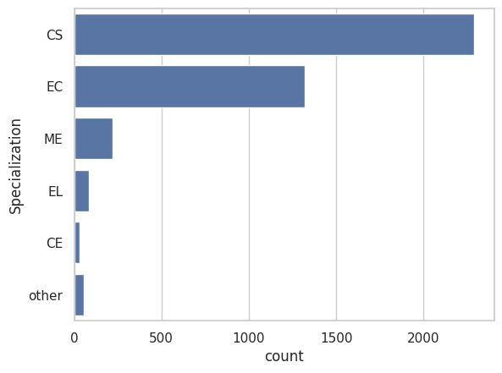
Univariate and Bivariate Analysis:
Specialization:
We have grouped the data by using Specialization and we have find that most people are from CS background and these are average salaries by groups:
Specialization | Salary
CE | 381206.896552
CS | 313245.958934
EC | 301467.020470
EL | 294705.882353
ME | 310836.363636
other | 317946.428571

Slide 7
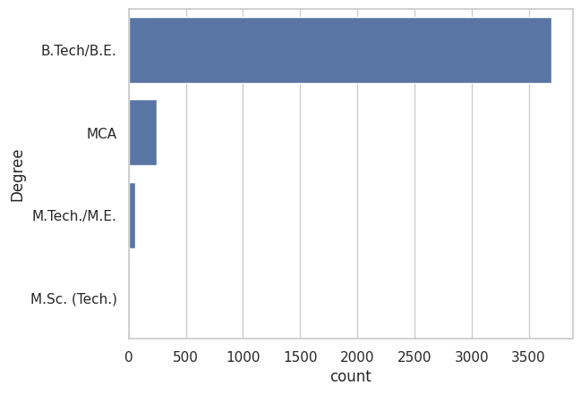
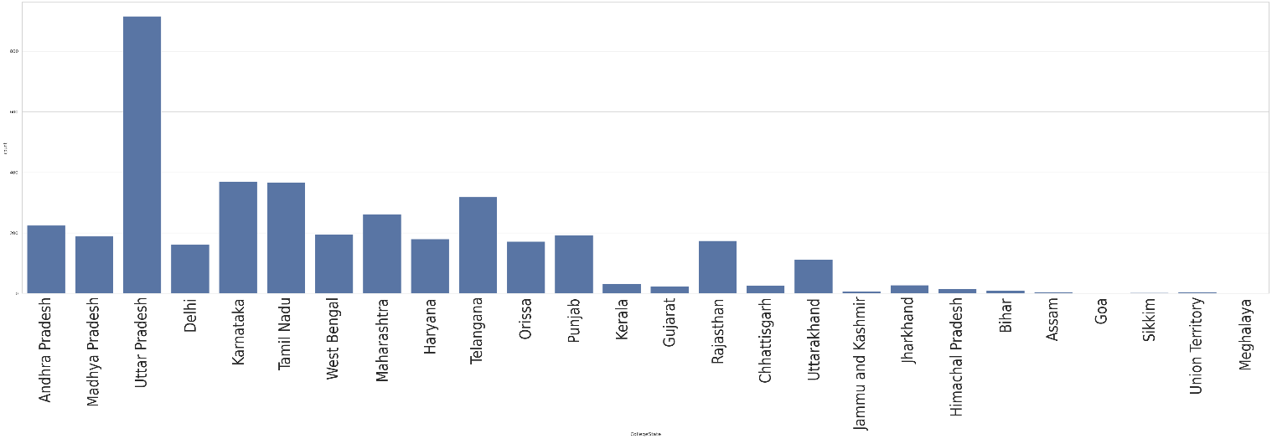
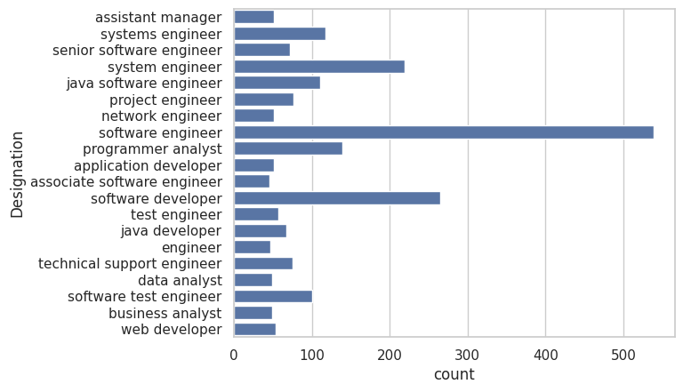
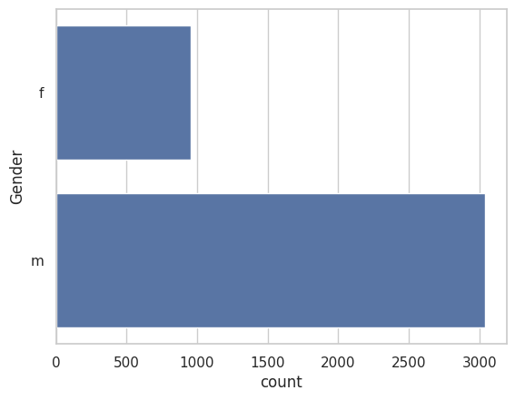
Degree:
Most of the Students are from B.Tech background.
College State:
Most of the Students from Uttar Pradesh.
Designation:
Gender:

Slide 8
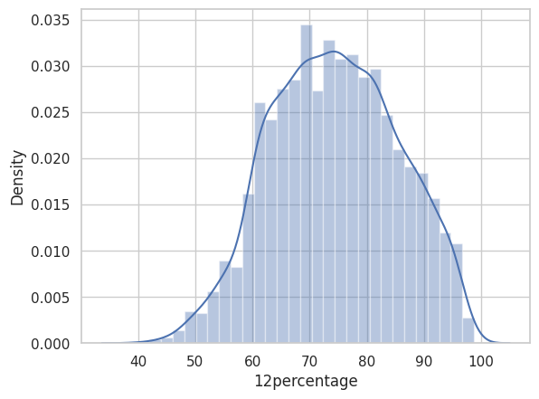
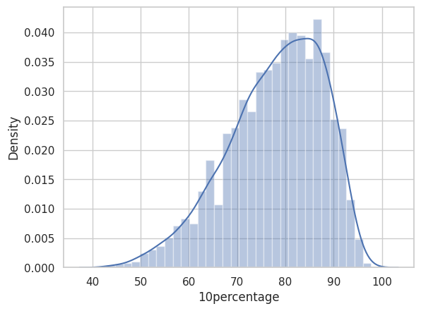
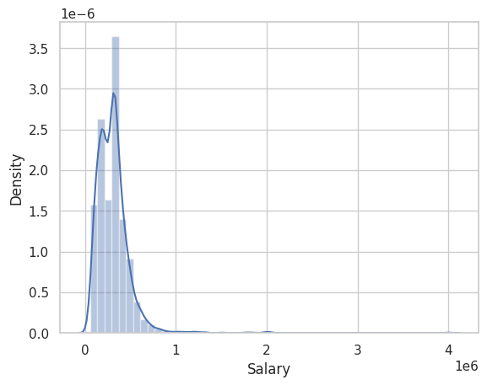
12th Percentage:
10th Percentage:
Salary:

Slide 9
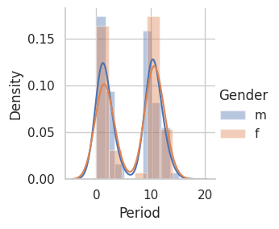
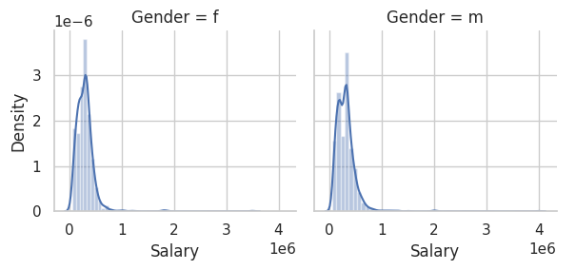
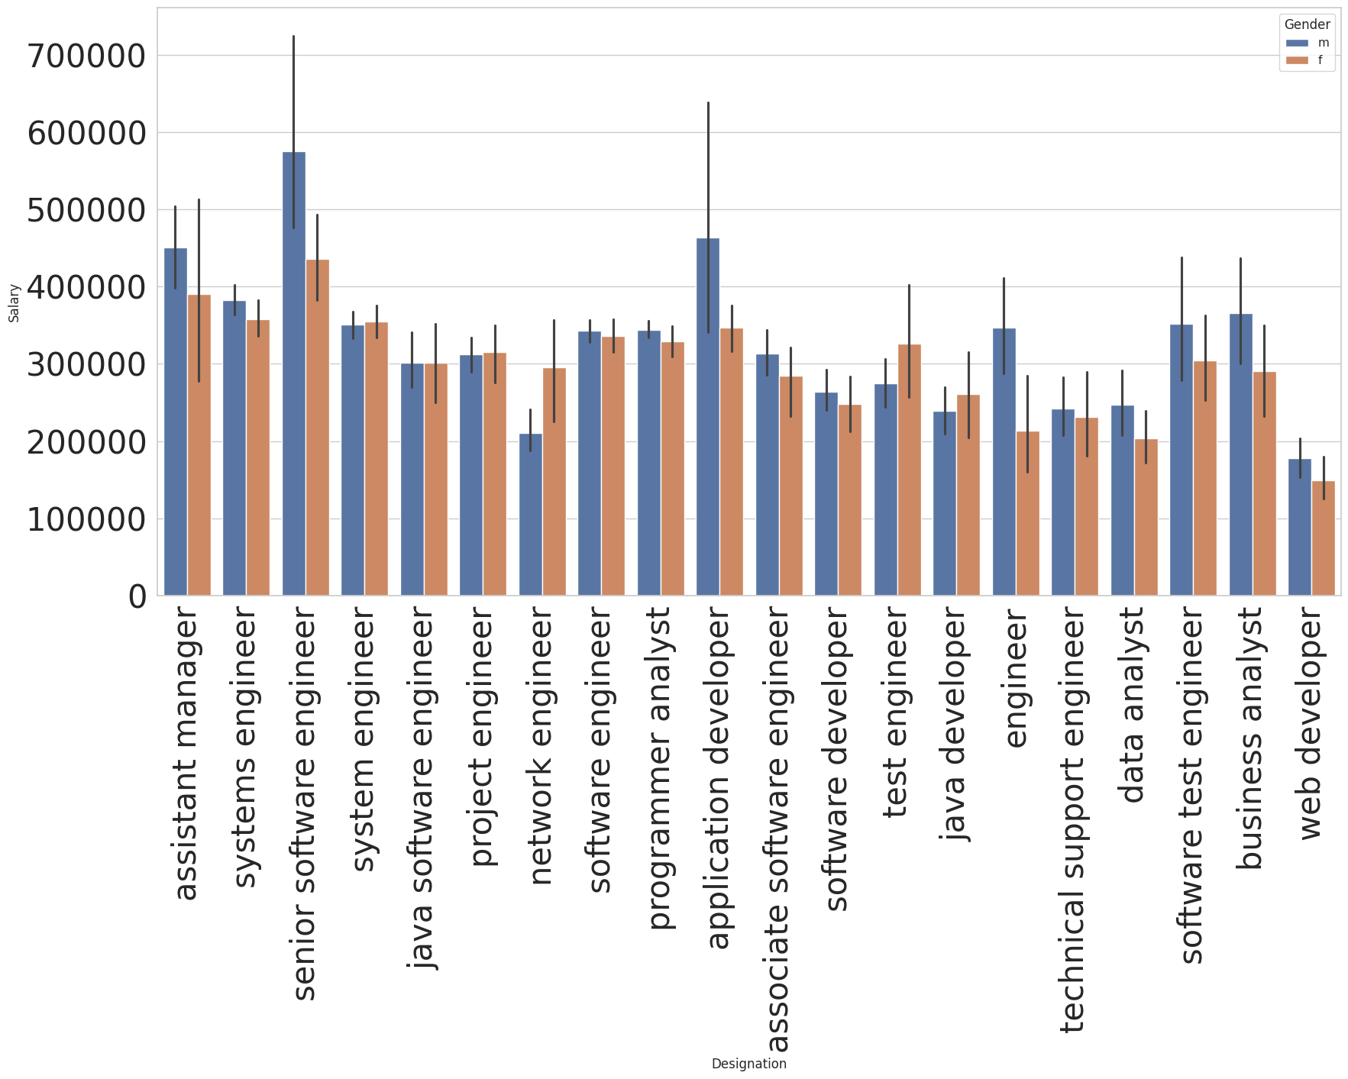
Gender & Salary:
Period & Gender:
Designation & Salary:

Slide 10
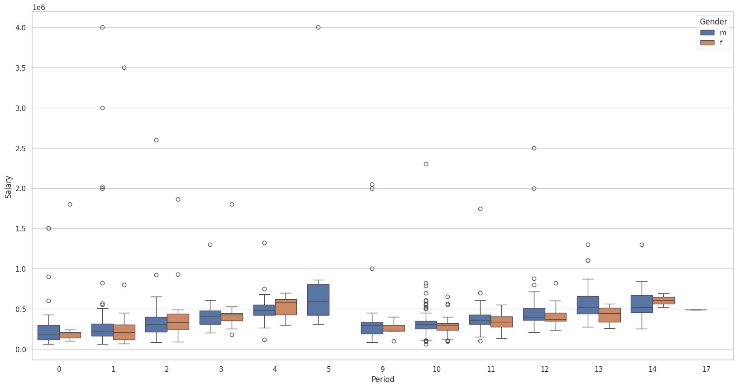
Period & Salary:
Median salary of both males and females have increases slightly with exp for first five years
and Decreased suddenly on the 6th year and then same pattern for the following years.
We can see that men and women having same experience are paid nearly equally around 3.5-5 lakhs
we need to further see the distribution of experience with respect to Designation for both men and women
To check whether women are being paid less in a role due to experience.

Slide 11
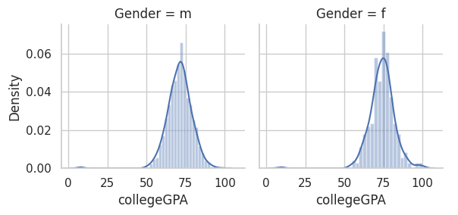
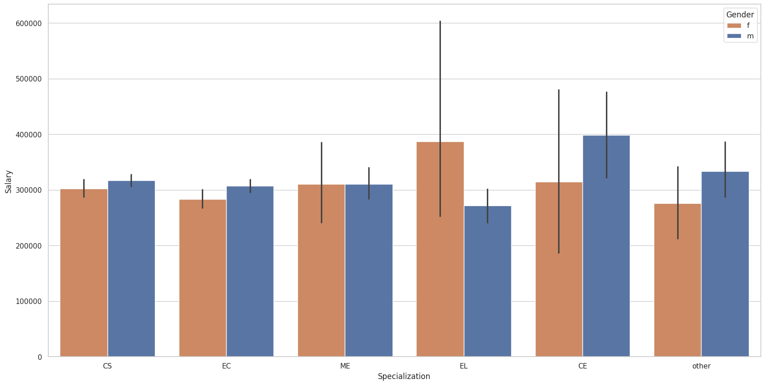
We can see how Similar both male and female distributions are for college GPA
IQR is narrow indication most number of students have similar cgpa in 70-75% region.
There are some students with CGPA < 20 and CGPA>90
We can see both distribution of college gpa vs male & female are normally distributed with mean around 75%.
Salary & Specialization:

Slide 12
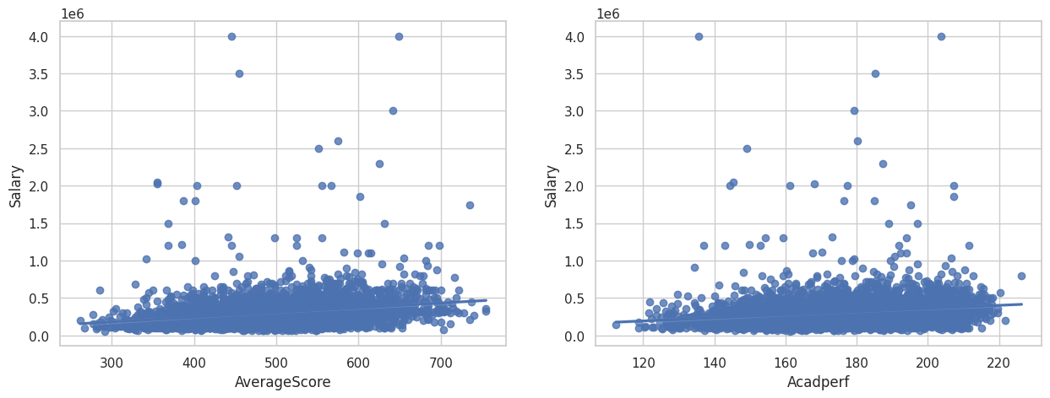
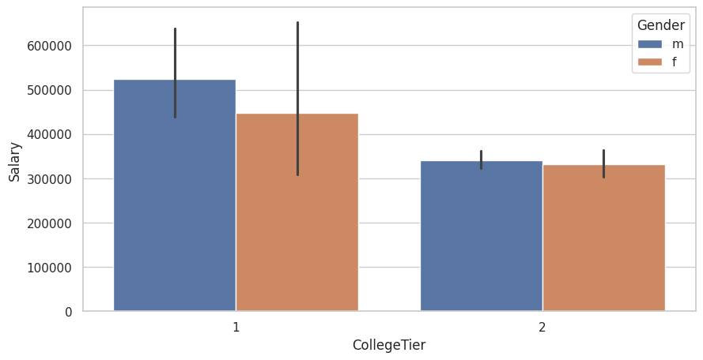
Salary & Average Score:
Salary & Academic Performance:
College Tier & Salary:

Slide 13
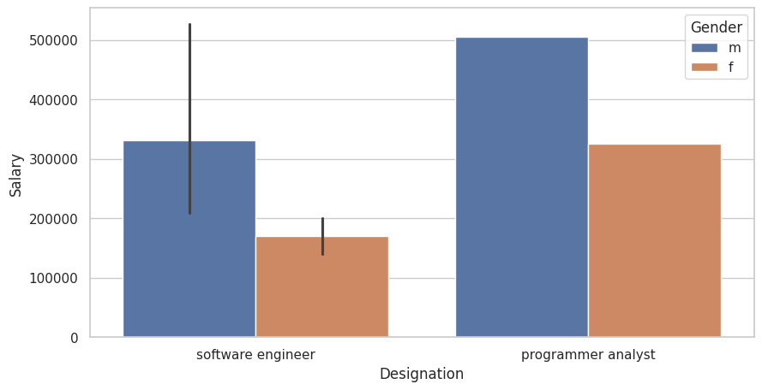
Research Conclusions:
Times of India article dated Jan 18, 2019 states that “After doing your Computer Science Engineering if you take up jobs as a Programming Analyst, Software Engineer, Hardware Engineer and Associate Engineer you can earn up to 2.5-3 lakhs as a fresh graduate.” Test this claim with the data given to you.
For Freshers, the salary is starting from 200k and male are earning more than female as a fresher.

Slide 14
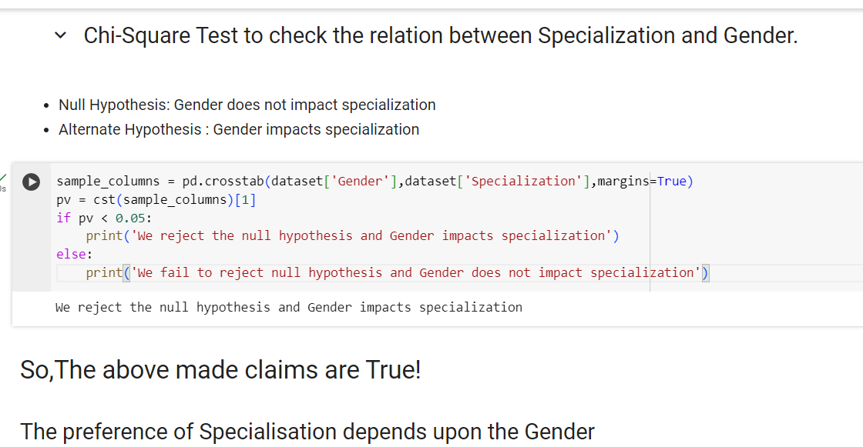
Is there a relationship between gender and specialization? (i.e. Does the preference of Specialisation depend on the Gender?)

Slide 15
Conclusions:
Most of AMCAT Aspirants are male working in IT domain with an experience of around 5years with degree in B.tech and specialization in Computer Science Information Technology from tier-2 college in Uttar Pradesh with an average salary around 300k.
Highpaying jobs taken up by amcat aspirants are mostly from 'IT' Domain.
Software Engineer and Software Developer are the most aimed profession for AMCAT aspirants.

